Slide 1



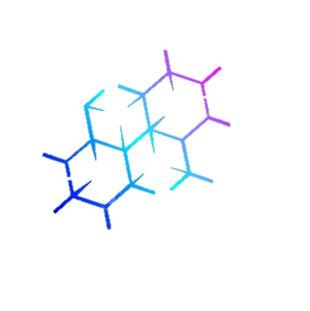
Node-red dan IoT Simulation Pada Google Colab & Heroku utk run Algoritma dgn Worse Case Rendah
Selasa, 08 Maret 2022
Mata Kuliah | Desain dan Analisis Algoritma
#Lab. Komputasi Cerdas (KC) #Kuliah Hybrid Bertahap di Prodi Studi Teknik Informatika, Filkom UB
#Merdeka Belajar
#Cegah Covid-19
Oleh: Imam Cholissodin | imamcs@ub.ac.id
Dosen Fakultas Ilmu Komputer (Filkom) UB

Slide 2

Outlines
Install npm dan node-red di Heroku
Setting node-red
Desain Arsitektur Simulator IoT
Konfigurasi dengan flespi.io/#/panel/list/sessions
Import contoh Workflow *.json
Run "IoT Simulator + flespi MQTT Broker" dgn tunnel
Done :D
DAA
Mata Kuliah | Desain dan Analisis Algoritma
Oleh: Imam Cholissodin | imamcs@ub.ac.id | Fakultas Ilmu Komputer (Filkom) UB

Slide 3
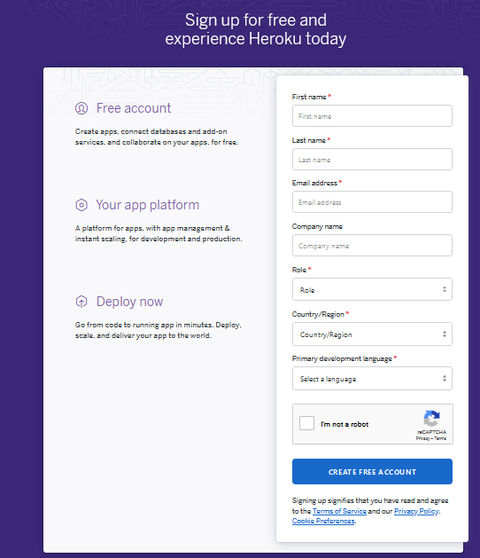
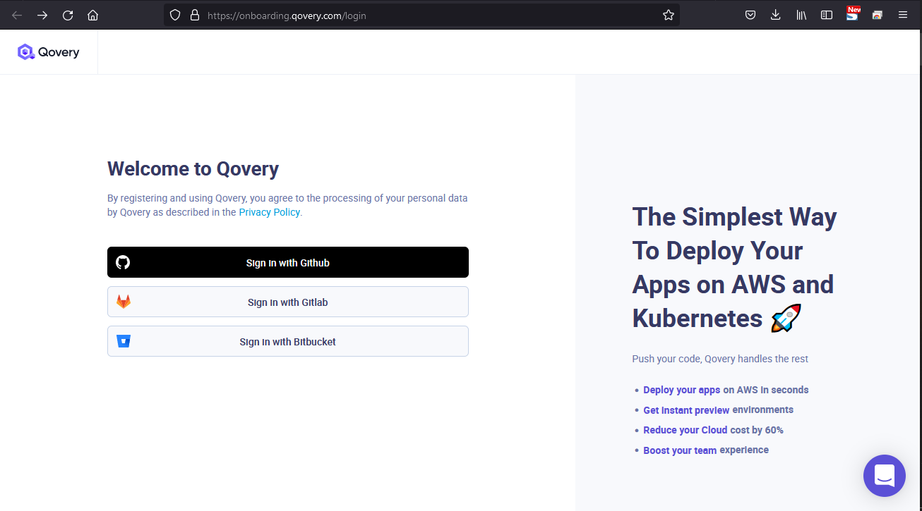
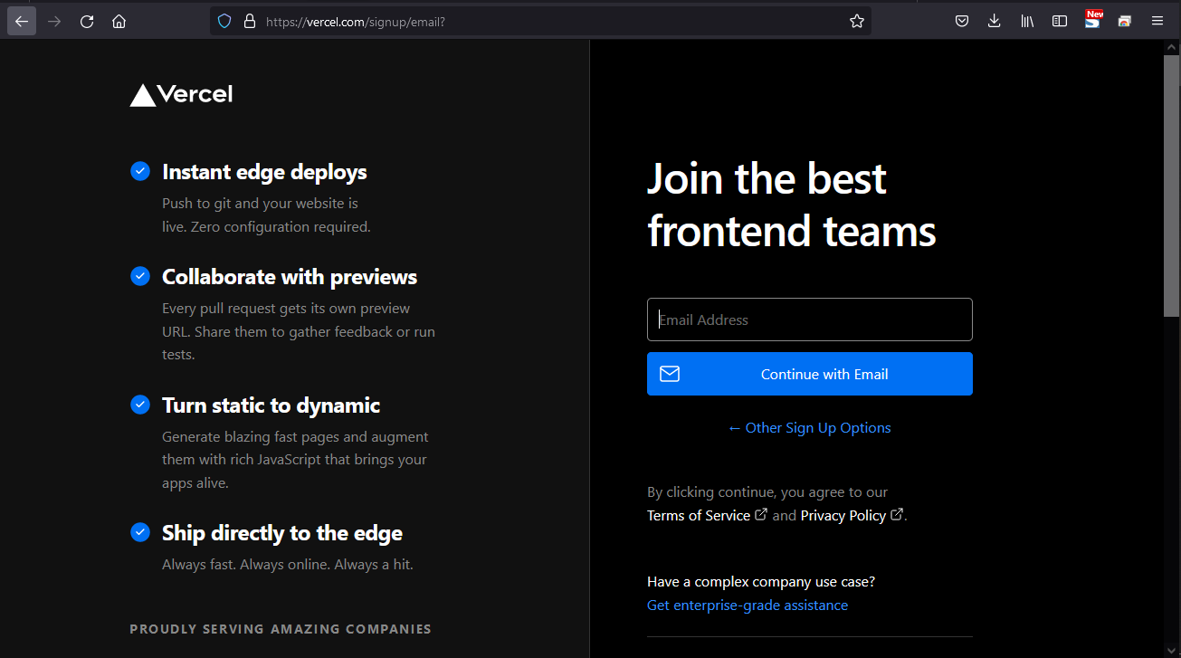

Pengantar Free Hosting for Edu | node-red / Flask Web / Flutter App
Register ke Heroku https://signup.heroku.com/ | https://www.qovery.com/pricing/ | https://vercel.com/signup
Mata Kuliah | Desain dan Analisis Algoritma
Oleh: Imam Cholissodin | imamcs@ub.ac.id | Fakultas Ilmu Komputer (Filkom) UB
Notes:
https://geshan.com.np/blog/2021/01/free-nodejs-hosting/
https://kaffeine.herokuapp.com/#!
https://www.ismaillowkey.net/2021/05/deploy-node-red-di-heroku.html?m=0
https://cron-job.org/en/
https://cronitor.io/cron-job-monitoring
Keep alive heroku | https://flows.nodered.org/flow/3d16d0afb081f48fda4b9d0db0b29869
https://www.youtube.com/watch?v=b3dcdCzYTpU | deploy Flask Project ke Heroku

Slide 4
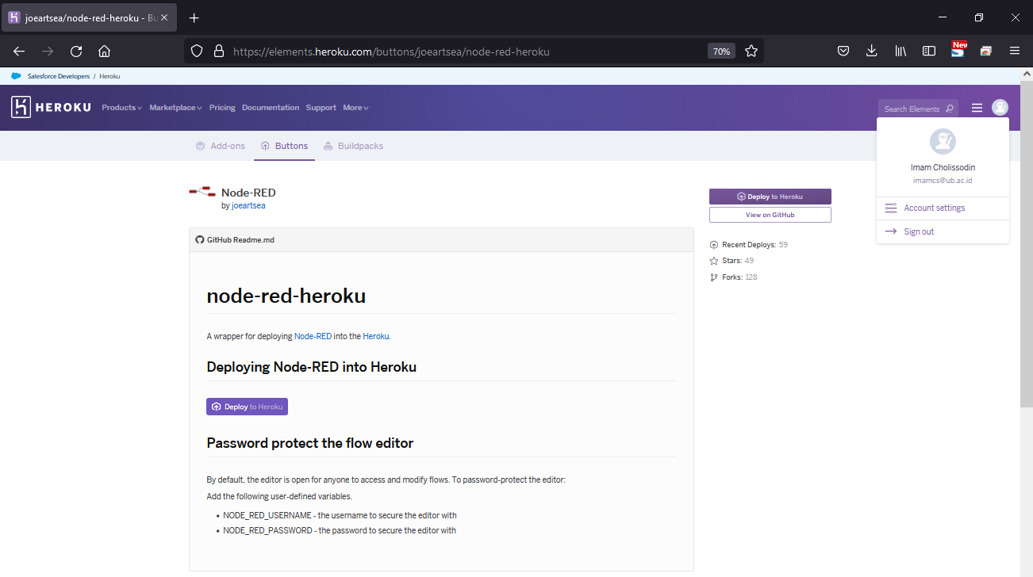
Pengantar | node-red
Register ke Heroku https://signup.heroku.com/ setelah login, masuk ke link https://elements.heroku.com/buttons/joeartsea/node-red-heroku
Mata Kuliah | Desain dan Analisis Algoritma
Oleh: Imam Cholissodin | imamcs@ub.ac.id | Fakultas Ilmu Komputer (Filkom) UB
Notes:
https://flespi.com/blog/node-red-flespi-for-easy-automation-of-everyday-tasks
https://github.com/phyunsj/iot-device-simulator-1-mqtt
https://github.com/Sevenmojoe/nodered-heroku

Slide 5
Outlines
Install npm dan node-red di Google Colab
Setting node-red
Desain Arsitektur Simulator IoT
Konfigurasi dengan flespi.io/#/panel/list/sessions
Import contoh Workflow *.json
Run "IoT Simulator + flespi MQTT Broker" dgn tunnel
Done :D
DAA
Mata Kuliah | Desain dan Analisis Algoritma
Oleh: Imam Cholissodin | imamcs@ub.ac.id | Fakultas Ilmu Komputer (Filkom) UB
Notes:
https://flespi.com/blog/node-red-flespi-for-easy-automation-of-everyday-tasks
https://github.com/phyunsj/iot-device-simulator-1-mqtt
https://github.com/Sevenmojoe/nodered-heroku

Slide 6
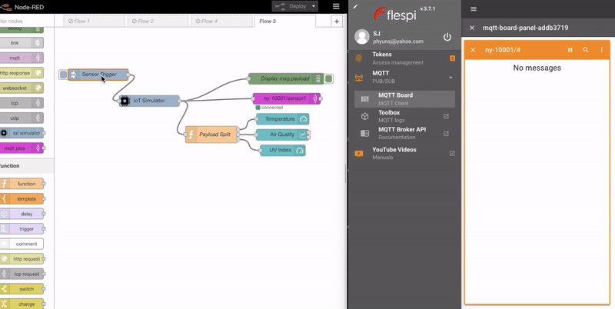
Pengantar | node-red
Desain Arsitektur Simulator IoT
Mata Kuliah | Desain dan Analisis Algoritma
Oleh: Imam Cholissodin | imamcs@ub.ac.id | Fakultas Ilmu Komputer (Filkom) UB
Notes:
https://flespi.com/blog/node-red-flespi-for-easy-automation-of-everyday-tasks
https://github.com/phyunsj/iot-device-simulator-1-mqtt
https://github.com/Sevenmojoe/nodered-heroku

Slide 7
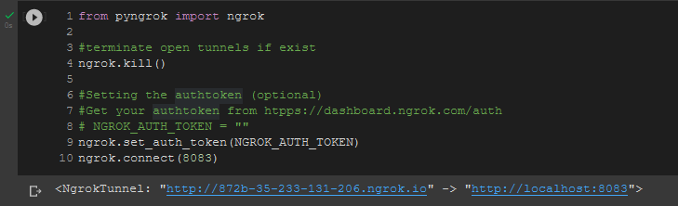
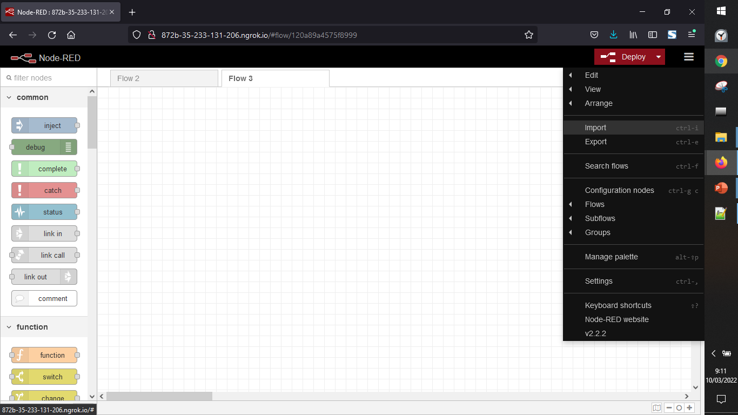
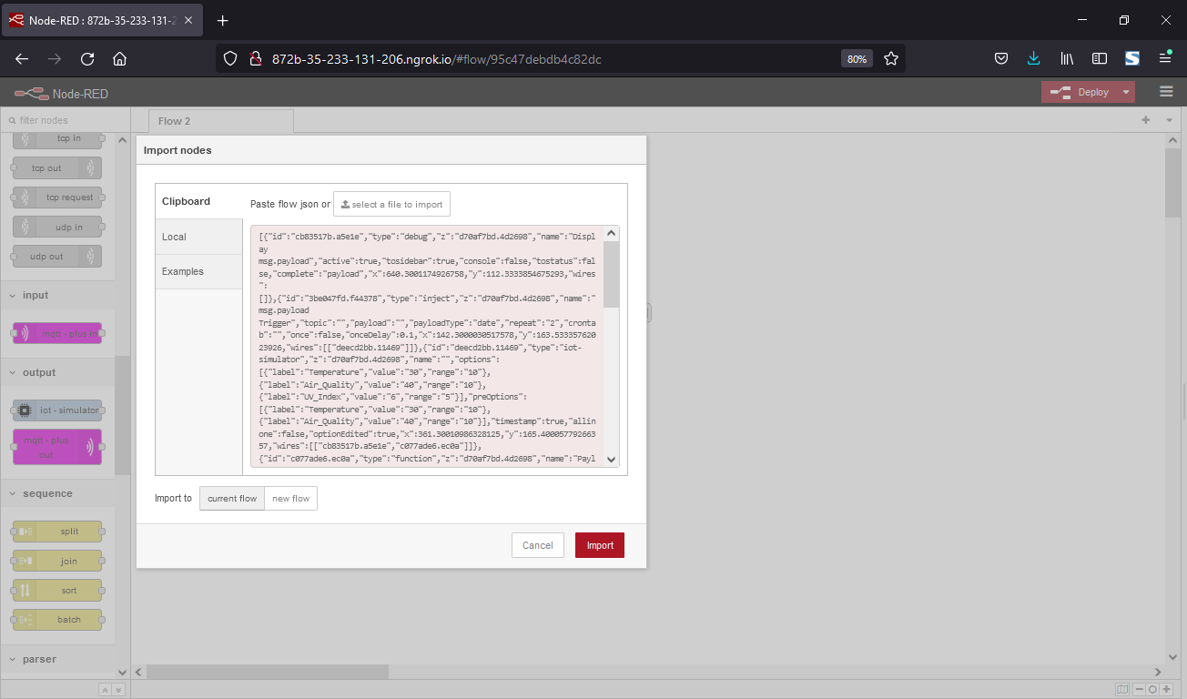
Pengantar | node-red
Import Contoh Workflow untuk get data “Temperature, Air_Quality dan UV_Index”, klik “Import”
Lalu copy isi file iot-simulator-temperature-air-uv.json berikut:
[{"id":"cb83517b.a5e1e","type":"debug","z":"d70af7bd.4d2698","name":"Display msg.payload","active":true,"tosidebar":true,"console":false,"tostatus":false,"complete":"payload","x":640.3001174926758,"y":112.3333854675293,"wires":[]},{"id":"3be047fd.f44378","type":"inject","z":"d70af7bd.4d2698","name":"msg.payload Trigger","topic":"","payload":"","payloadType":"date","repeat":"2","crontab":"","once":false,"onceDelay":0.1,"x":142.3000030517578,"y":163.53335762023926,"wires":[["deecd2bb.11469"]]},{"id":"deecd2bb.11469","type":"iot-simulator","z":"d70af7bd.4d2698","name":"","options":[{"label":"Temperature","value":"30","range":"10"},{"label":"Air_Quality","value":"40","range":"10"},{"label":"UV_Index","value":"6","range":"5"}],"preOptions":[{"label":"Temperature","value":"30","range":"10"},{"label":"Air_Quality","value":"40","range":"10"}],"timestamp":true,"allinone":false,"optionEdited":true,"x":361.30010986328125,"y":165.40005779266357,"wires":[["cb83517b.a5e1e","c077ade6.ec0a"]]},{"id":"c077ade6.ec0a","type":"function","z":"d70af7bd.4d2698","name":"Payload Split","func":"var msg1 = null\nif ( msg.payload[\"Temperature\"] !== undefined) {\n msg1 = {};\n msg1.payload = msg.payload[\"Temperature\"];\n}\n\nvar msg2 = null\nif ( msg.payload[\"Air_Quality\"] !== undefined){\n msg2 = {};\n msg2.payload = msg.payload[\"Air_Quality\"];\n}\n\nvar msg3 = null\nif ( msg.payload[\"UV_Index\"] !== undefined){\n msg3 = {};\n msg3.payload = msg.payload[\"UV_Index\"];\n}\nreturn [msg1, msg2, msg3];","outputs":3,"noerr":0,"x":524.3000946044922,"y":216.60003185272217,"wires":[["18af797e.554067"],["661f5e00.71c9b4"],["9e42205.31f5ae"]]},{"id":"18af797e.554067","type":"ui_gauge","z":"d70af7bd.4d2698","name":"Temperature","group":"5b9e6fe9.d44e3","order":0,"width":"4","height":"4","gtype":"gage","title":"Temperature","label":"°C","format":"{{value}} °C","min":0,"max":"100","colors":["#00b500","#e6e600","#ca3838"],"seg1":"","seg2":"","x":689.3003082275391,"y":169.40005111694336,"wires":[]},{"id":"661f5e00.71c9b4","type":"ui_chart","z":"d70af7bd.4d2698","name":"Air Quality","group":"5b9e6fe9.d44e3","order":1,"width":"4","height":"4","label":"Air Quality","chartType":"line","legend":"false","xformat":"HH:mm:ss","interpolate":"linear","nodata":"","dot":true,"ymin":"","ymax":"","removeOlder":1,"removeOlderPoints":"","removeOlderUnit":"3600","cutout":0,"useOneColor":false,"colors":["#1f77b4","#aec7e8","#ff7f0e","#2ca02c","#98df8a","#d62728","#ff9896","#9467bd","#c5b0d5"],"useOldStyle":false,"x":686.3002815246582,"y":226.40008354187012,"wires":[[],[]]},{"id":"9e42205.31f5ae","type":"ui_gauge","z":"d70af7bd.4d2698","name":"","group":"5b9e6fe9.d44e3","order":2,"width":"4","height":"4","gtype":"gage","title":"UV Index","label":"units","format":"{{value}}","min":"1","max":"12","colors":["#00b500","#e6e600","#ca3838"],"seg1":"6","seg2":"9","x":677.5234375,"y":290.9609375,"wires":[]},{"id":"5b9e6fe9.d44e3","type":"ui_group","z":"","name":"SensorData","tab":"a1882c32.fc82a","order":2,"disp":true,"width":"12","collapse":false},{"id":"a1882c32.fc82a","type":"ui_tab","z":"","name":"Dashboard","icon":"dashboard","order":1}]
Mata Kuliah | Desain dan Analisis Algoritma
Oleh: Imam Cholissodin | imamcs@ub.ac.id | Fakultas Ilmu Komputer (Filkom) UB
Notes:
https://flespi.com/blog/node-red-flespi-for-easy-automation-of-everyday-tasks
https://github.com/phyunsj/iot-device-simulator-1-mqtt
https://github.com/Sevenmojoe/nodered-heroku

Slide 8
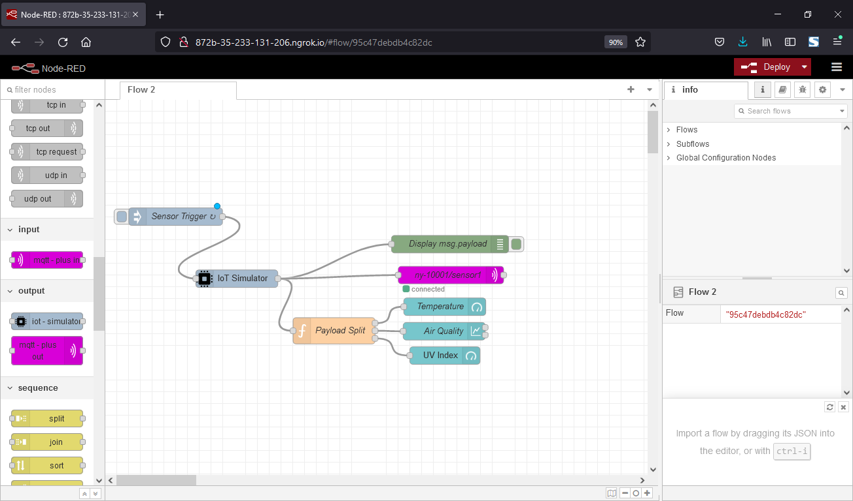
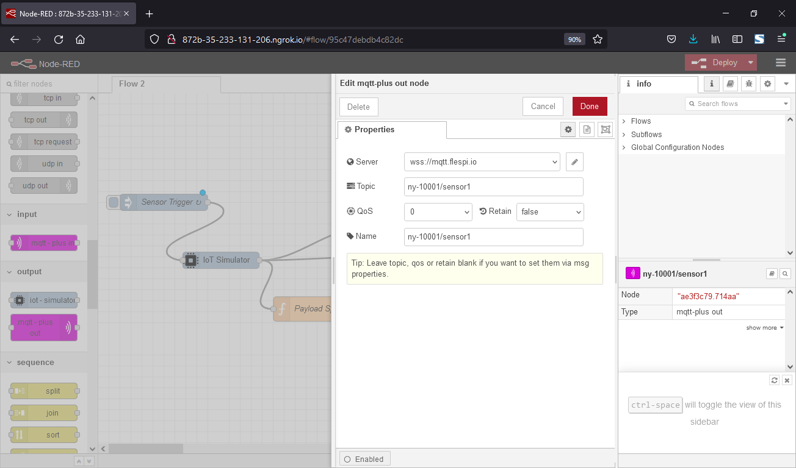
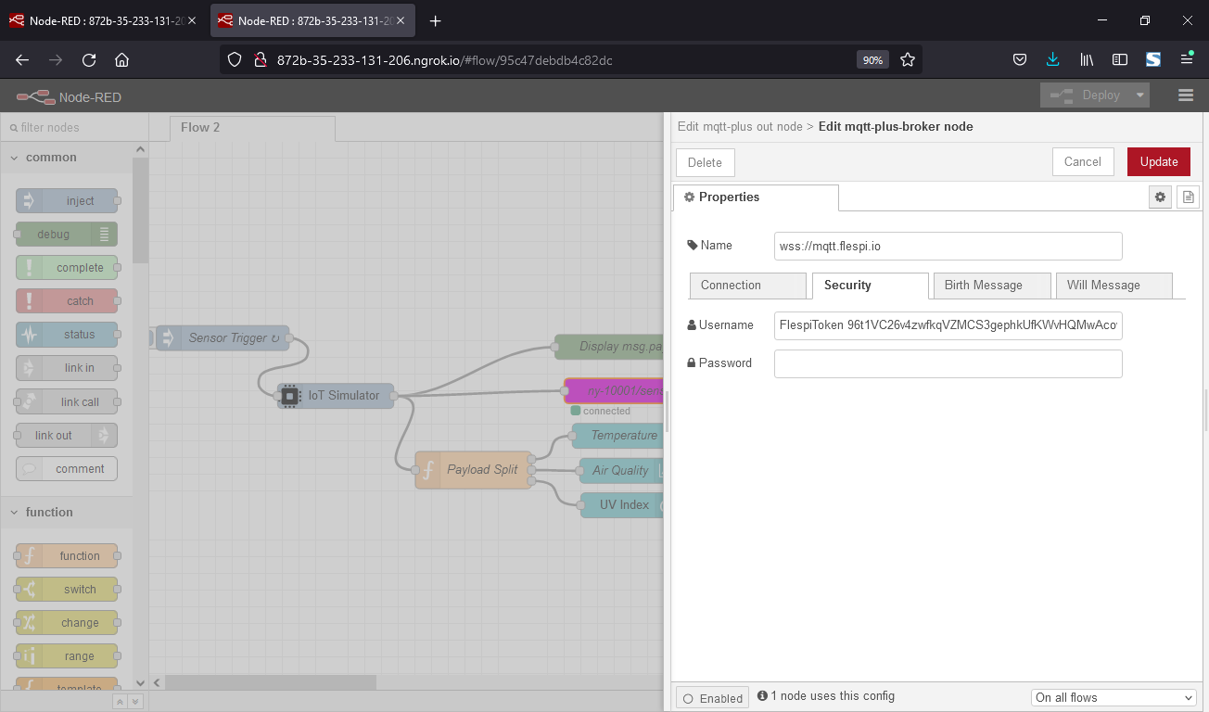
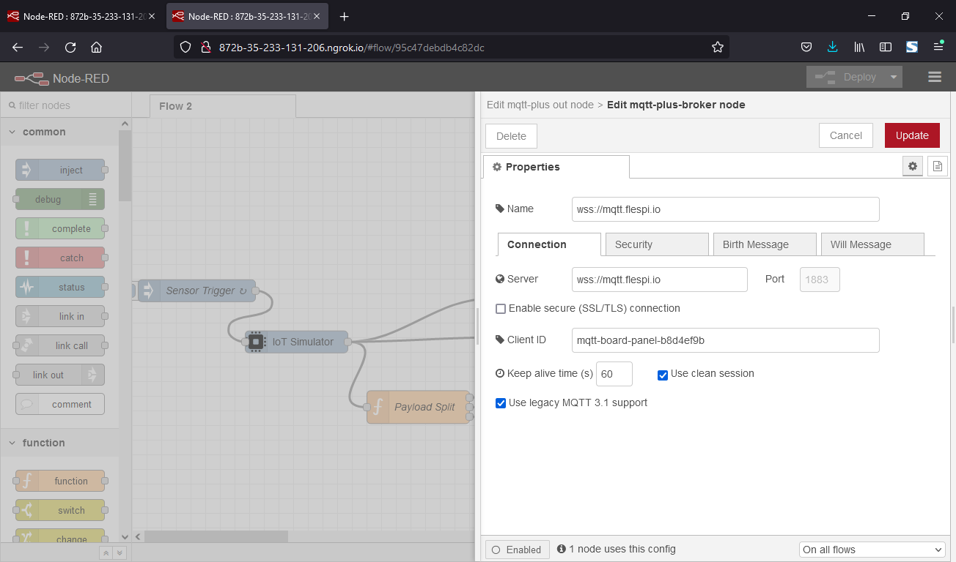
Pengantar | node-red
Hasil Import Workflow, lalu double klik “ny-10001/sensor1”, lalu masukkan data berikut
Lalu klik bagian icon “pen”, masukkan data berikut
Lalu klik “Update”, klik “Done”
Mata Kuliah | Desain dan Analisis Algoritma
Oleh: Imam Cholissodin | imamcs@ub.ac.id | Fakultas Ilmu Komputer (Filkom) UB
Notes:
https://flespi.com/blog/node-red-flespi-for-easy-automation-of-everyday-tasks
https://github.com/phyunsj/iot-device-simulator-1-mqtt
https://github.com/Sevenmojoe/nodered-heroku

Slide 9
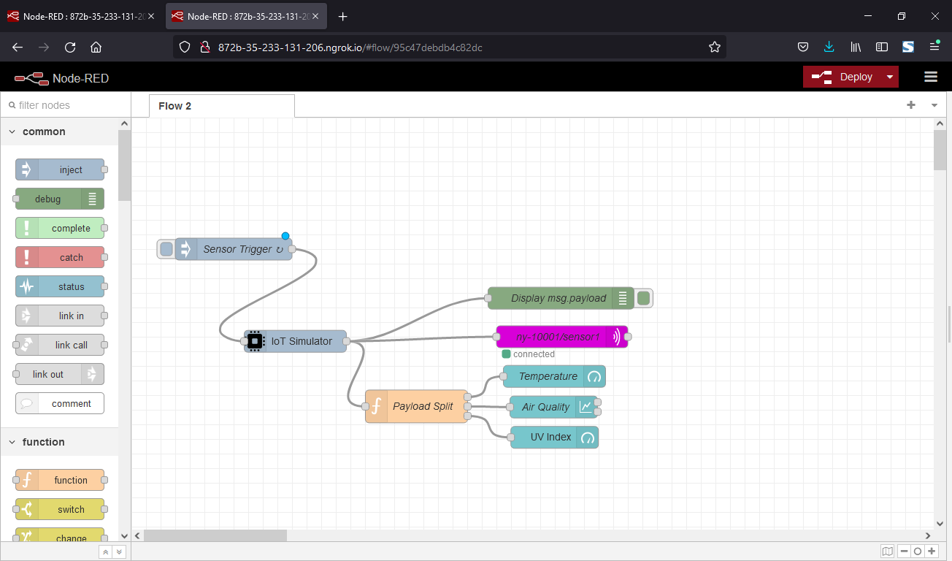
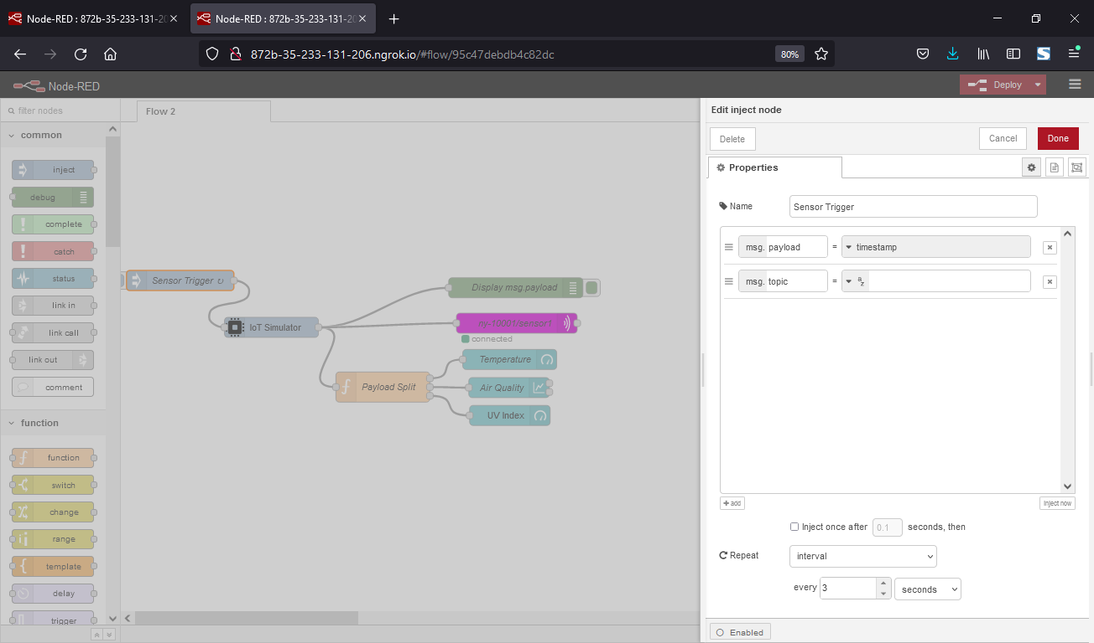
Pengantar | node-red
Setting interval waktu pengambilan data, klik “Sensor Trigger”
Lalu Klik “Deploy’
Pada bagian “Repeat”, misal pilih interval 3 seconds.
Lalu klik “Done”
Mata Kuliah | Desain dan Analisis Algoritma
Oleh: Imam Cholissodin | imamcs@ub.ac.id | Fakultas Ilmu Komputer (Filkom) UB
Notes:
https://flespi.com/blog/node-red-flespi-for-easy-automation-of-everyday-tasks
https://github.com/phyunsj/iot-device-simulator-1-mqtt
https://github.com/Sevenmojoe/nodered-heroku

Slide 10
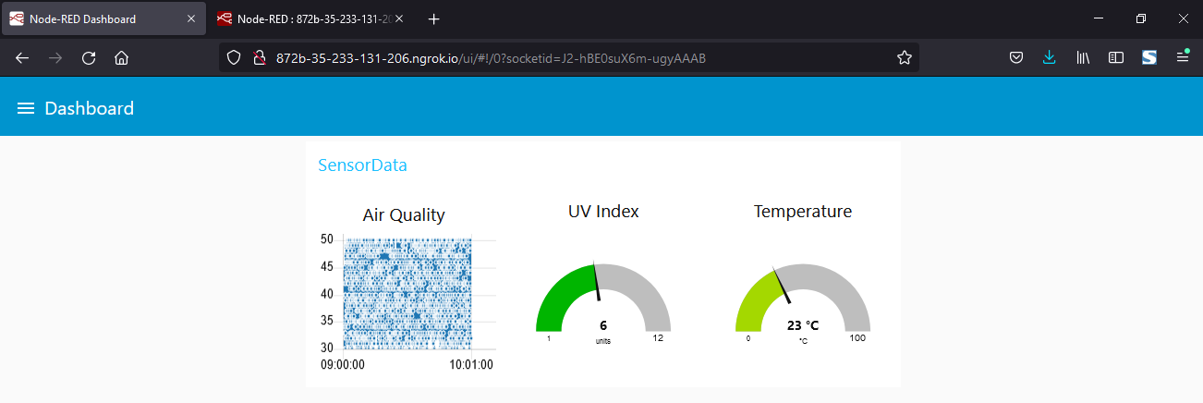
Pengantar | node-red
Cek Tampilan ui secara realtime, yaitu setelah “….ngrok.io” tambahkan “/ui”, pada link http://872b-35-233-131-206.ngrok.io/ui
Mata Kuliah | Desain dan Analisis Algoritma
Oleh: Imam Cholissodin | imamcs@ub.ac.id | Fakultas Ilmu Komputer (Filkom) UB
Notes:
https://flespi.com/blog/node-red-flespi-for-easy-automation-of-everyday-tasks
https://github.com/phyunsj/iot-device-simulator-1-mqtt
https://github.com/Sevenmojoe/nodered-heroku

Slide 11
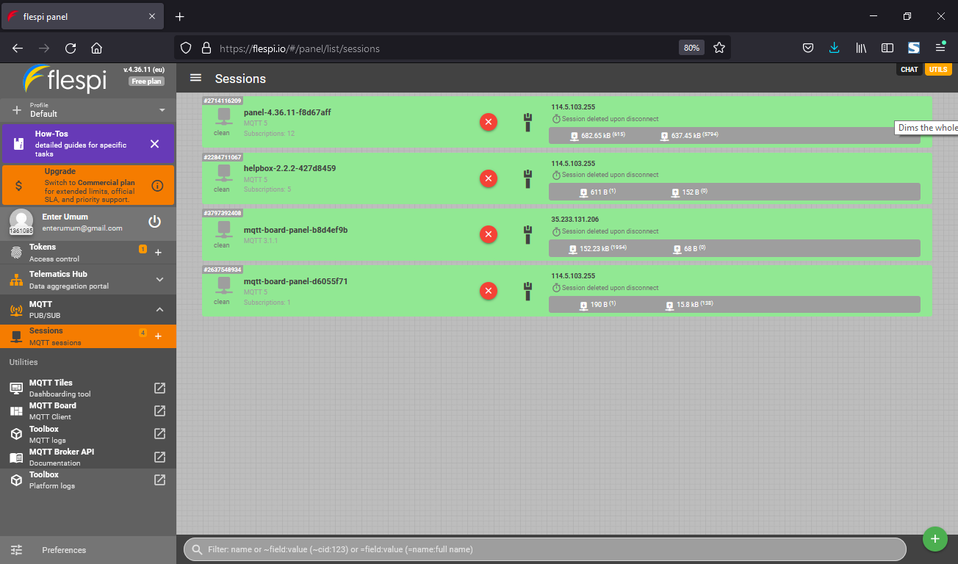
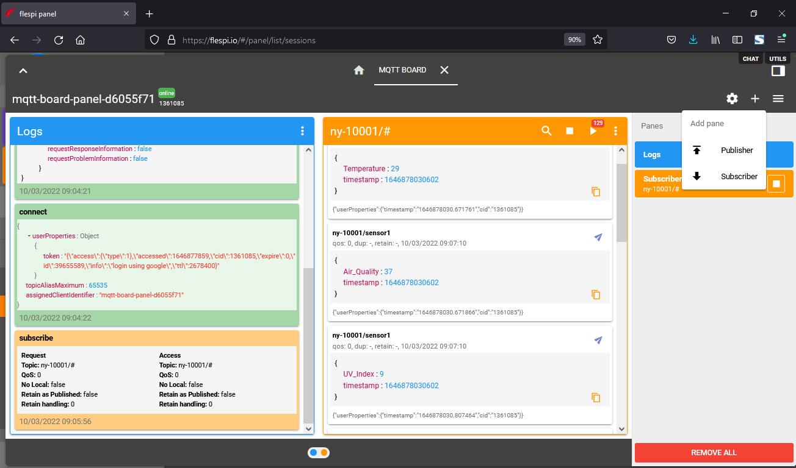
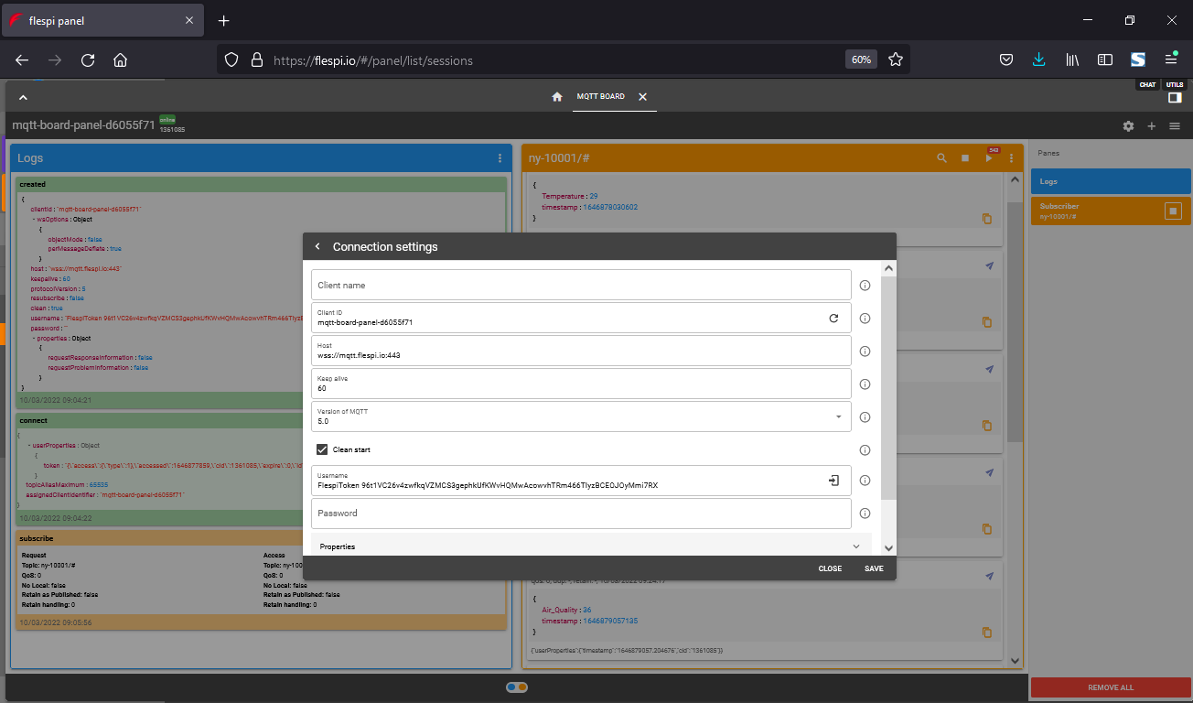
Pengantar | node-red
Pada web flespi, klik “MqTT Board”, lalu klik tombol setting isikan Client ID, klik Save, lalu klik “Subcriber” dengan Topic “ny-10001/#”, klik tombol run/Subcribe
Mata Kuliah | Desain dan Analisis Algoritma
Oleh: Imam Cholissodin | imamcs@ub.ac.id | Fakultas Ilmu Komputer (Filkom) UB
Notes:
https://flespi.com/blog/node-red-flespi-for-easy-automation-of-everyday-tasks
https://github.com/phyunsj/iot-device-simulator-1-mqtt
https://github.com/Sevenmojoe/nodered-heroku

Slide 12
Terimakasih
#Lab. Komputasi Cerdas (KC) #Kuliah Hybrid Bertahap di Prodi Studi Teknik Informatika, Filkom UB
#Merdeka Belajar
#Cegah Covid-19
Oleh: Imam Cholissodin | imamcs@ub.ac.id
Dosen Fakultas Ilmu Komputer (Filkom) UB

